Slide 1

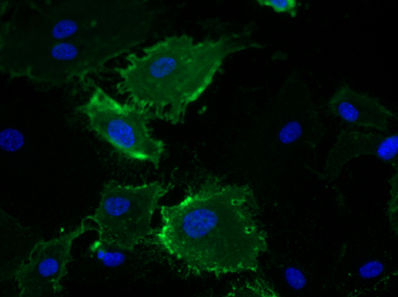
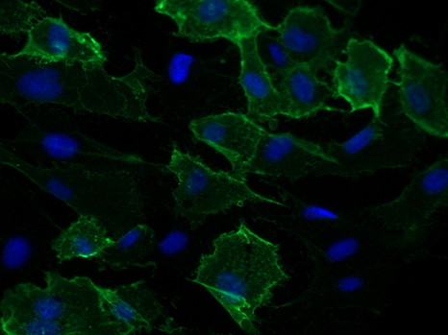
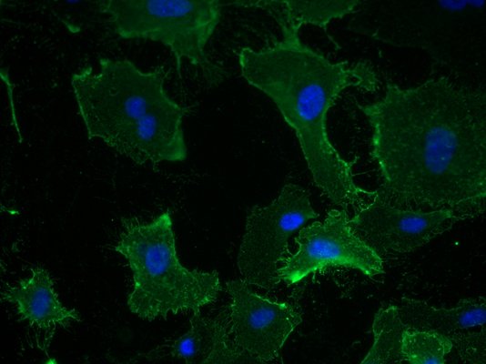

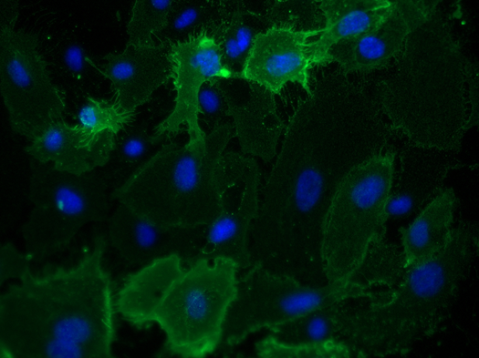
Reliatech GmbH
Mouse anti-human CD31 (#WM59)
(Cat #101-M92 / HU1402-01)
0,5µg/ml
2µg/ml
5µg/ml
Fig. 1: Immunofluorescence staining of human CD31 (red) in HUVEC with a monoclonal mouse anti-human CD31 antibody [Cat# 101-M92]. Conjugated secondary antibody: goat anti-mouse ALEXA Flour 488 [Dianova].
[IF_HU1402-01]
1µg/ml (#158-2B3)
http://www.reliatech.de / orders@reliatech.de

